Slide 1
Unit 9
What does he look like?
Section B 3a-Self Check
七年级(下)

Slide 2
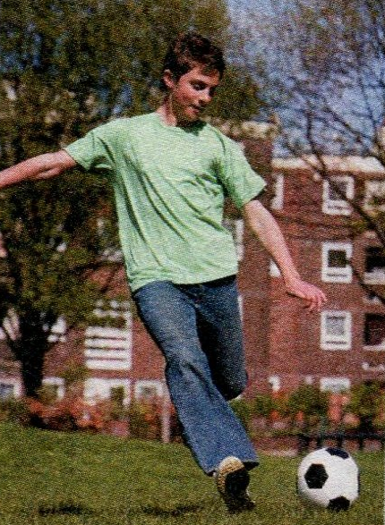
3a. Jack is Jill’s best friend. Fill in the
blanks with the words in the box.
looks glasses straight shoes handsome
My best friend is Jack. Let me tell you what he
_________ like. First of all, he is very tall
and _________. He has _________brown
hair and he doesn’t wear_________. He usually
wears jeans , a T-shirt and sports
_________. I like him because
he is really cool and fun, and he
is good at soccer.
looks
handsome
straight
glasses
shoes

Slide 3

3b. Write a passage about your best
friends. These questions may be
help you.
What is your friend’s name?
What does he / she look like?
What does he / she like to wear?
Why do you like him / her?

Slide 4
My friend
______________________________________
______________________________________
______________________________________
______________________________________
_______________________________________

Slide 5
写作: 假如你在 Internet 上结识了一位名叫
Mary的网友,请根据她发给你的有关信息,
向同学简单介绍.
年龄 | 学校 | 籍贯 | 外貌特征 | 爱好
15 | Apple Tree School | 澳大利亚 悉尼市 | 大眼睛, 黑色长卷发, 中等身材, 有点胖 | 喜欢穿蓝色衣服, 喜欢读书, 上网聊天 (chat)

Slide 6
My Net Friend Mary
I have a net friend. She is from Sydney,
Australia. The girl is fifteen years old and
is studying at Apple Tree School. She is
of medium height and a little bit heavy
with big eyes. She has long black curly hair.
She likes to wear blue dress. In her spare
time she likes reading and chatting on the
net. I like my net friend very much.

Slide 7

1 Write more words in the box.
Describing People
Height
tall
Hair
long
Other Features
glasses
Height
tall
Height
tall
Build
thin
short
heavy
short
curly
beautiful
straight
handsome
cute

Slide 8
2 What do your parents look like? Describe them.
My father is tall ____________________
___________________________________
__________________________________
_________________________________
_________________________________
___________________________________

Slide 9
Sample
My father is tall. He’s of medium height. He has short straight hair. He has small eyes and a big mouth. He always wears a blue jacket and black trousers. He wears a pair of glasses.
___________________________________
___________________________________
___________________________________
___________________________________
___________________________________

Slide 10

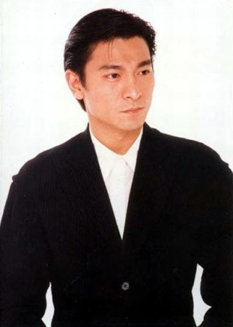
Look at the picture and fill in the blanks.
A: What’s your _______ singer?
B: My favorite singer is Andy Lau.
A: What does he ____ ____?
favorite
look like

Slide 11
B: He is of ________ ______. He has _____ _____ hair. He doesn’t _____ glasses.
A: What ______ does he like?
B: He likes bowling and tennis.
A: _____ do you like him?
B: Because he’s a great singer.
medium height
short black
wear
sports
Why

Slide 12
Key sentences for describing people:
(描述人的重点句型)
What does he/she look like?
1) He/She is of medium height/tall/short
/fat/heavy/thin/strong/bald.
2) He /She has short straight hair/long
curly hair/blonde curly hair/a beard/
a mustache.
3) He/She wears glasses/a T-shirt.

Slide 13
Exercises
Ⅰ. 翻译下面的句子
1.-- 你的朋友长的怎么样?
-- 她中等个子, 卷头发。
--What ____ your friend ____ ____?
--She _____ ___ _______ _______ and she
has _____ ____.
does
look like
is of medium height
curly hair

Slide 14
2. 你妹妹长的怎么样? 她很高,很瘦,长长
的直发。
--What does your sister _____ _____?
--She is ____ and ____, and she has ____
______ ______.
3. Lucy的爸爸是足球队队长。
Lucy’s father is ____ _______ ____the
football team.
look like
tall
thin
long
straight hair
the captain of

Slide 15
Ⅱ. 根据所给首字母补全句子
1. That boy is really t____. He is a
basketball player.
2. I like swimming. So my hair is very
s_____.
3. Tom’s father is not tall. He is of
m_______ height.
all
hort
edium

Slide 16
4. Our English teacher is good –looking
with a medium h_____.
5. The pop star is really cool. He has long
and s_______ hair.
eight
traight

Slide 17
III. 选词填空
blonde curly glasses bald
medium height
glasses
1. I have a new look. Now I wear ________.
2. He has no hair. He is ______.
3. Her hair is very straight. It is not ______.
bald
curly

Slide 18
4. He is not short or tall . He’s of
______________.
5. Her hair is not black or brown. It is
________.
medium height
blonde

Slide 19

1. 总结描述人物形象、穿戴的一些词汇，强化记忆。
2. 描述一下自己的祖父母或叔叔、姑姑等人物。

Slide 20
Thank You!

